Slide 1
Student exam scheduler
Team:
Ioana Chelaru
Stefan cîrstea

Slide 2
description
This project automates the exams scheduling process by creating an event in the specified Google Calendar account for each exam of the given student. The data is provided by the university's website. The robot is used for each student identified by specialization, year of study and e-mail address.
Input: .doc file with the exam dates, the specialization, year of study and e-mail address of the given student
Output: the Google Calendar is updated with the newly created events according to the exams planification
Apps: MS Word/Excel, browser, mail

Slide 3
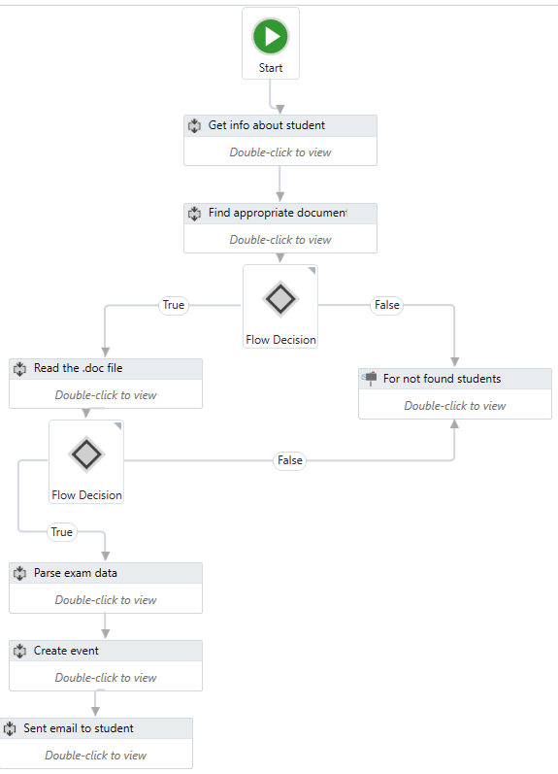

Slide 4
Exceptional situations
The first situation we encountered was the one in which the field and year of study of the student couldn't be found in the university's files. To treat this case, we used a flow decision activity in which we check with the help of a boolean variable if the student was found.
Another problem we found was that if the student was in a terminal year, then he would have some optional subjects and we couldn't know which subject he has chosen from the many available. Furthermore, the university's files do not provide any exam dates for those subjects. In solution, we decided to include a warning message in the email we sent to the user.

Slide 5
//challenges in the implemetation

Slide 6
//conclusions

Slide 7


